Slide 1
Rational Decisions
Lesson 5

Slide 2
Outline
Rational preferences
Utilities
Money
Multiattribute utilities
Decision networks
Value of information

Slide 3
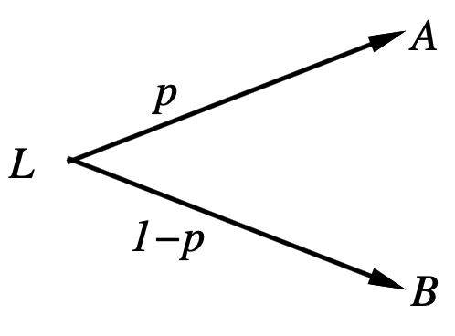
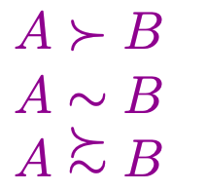
Preferences
An agent chooses among prices (A, B, etc.) and lotteries, i.e., situations with uncertain prizes
Lottery L =[p, A; (1 - p), B]
Notation:
A preferred to B
Indifference between A and B
B not preferred to A

Slide 4
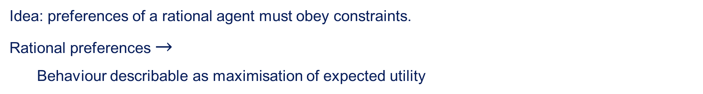
Rational preferences
Idea: preferences of a rational agent must obey constraints.
Rational preferences $→$
Behaviour describable as maximisation of expected utility
Constraints
Orderability
Transitivity
Continuity
Sustitutability
Monotonicity

Slide 5
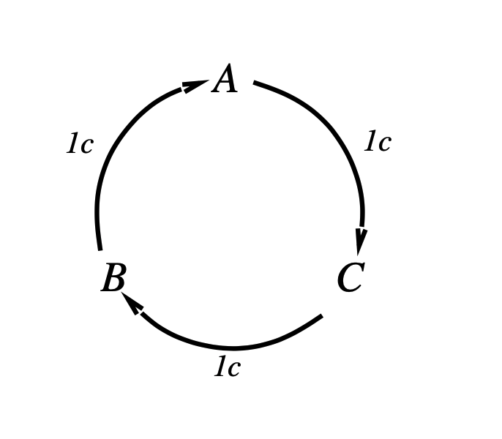
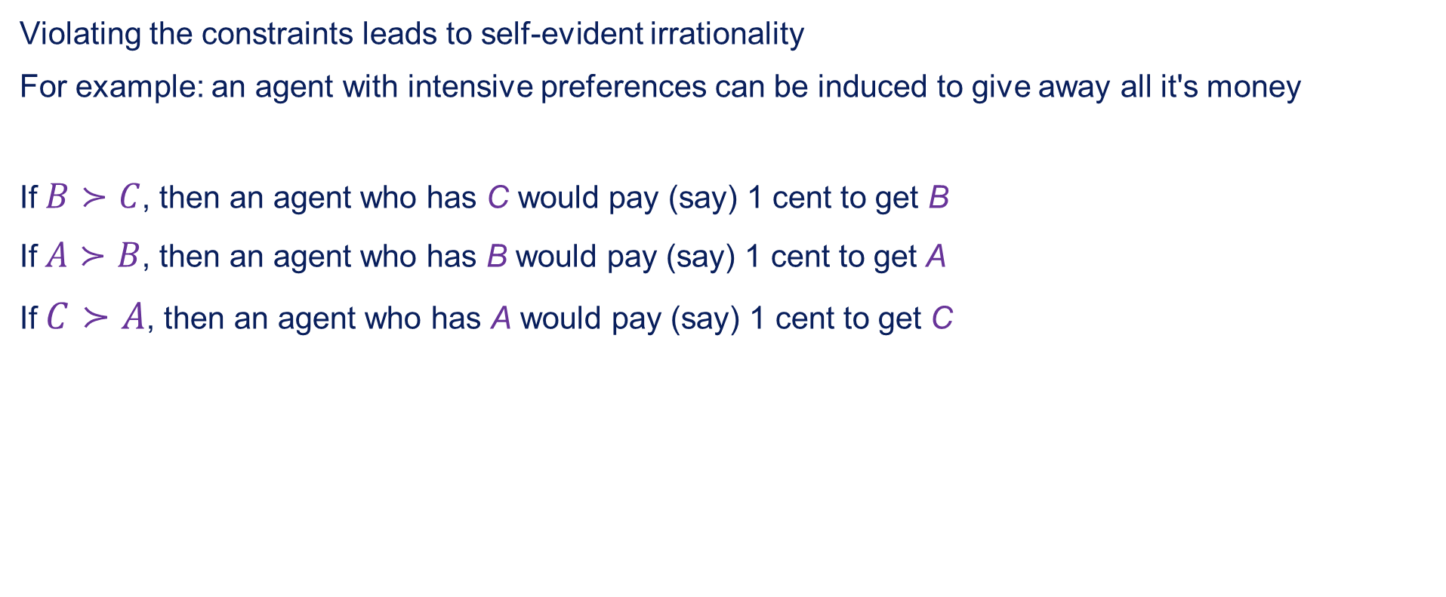
Rational preferences continued
Violating the constraints leads to self-evident irrationality
For example: an agent with intensive preferences can be induced to give away all it's money
If $B≻C$, then an agent who has C would pay (say) 1 cent to get B
If $A≻B$, then an agent who has B would pay (say) 1 cent to get A
If $C≻A$, then an agent who has A would pay (say) 1 cent to get C

Slide 6
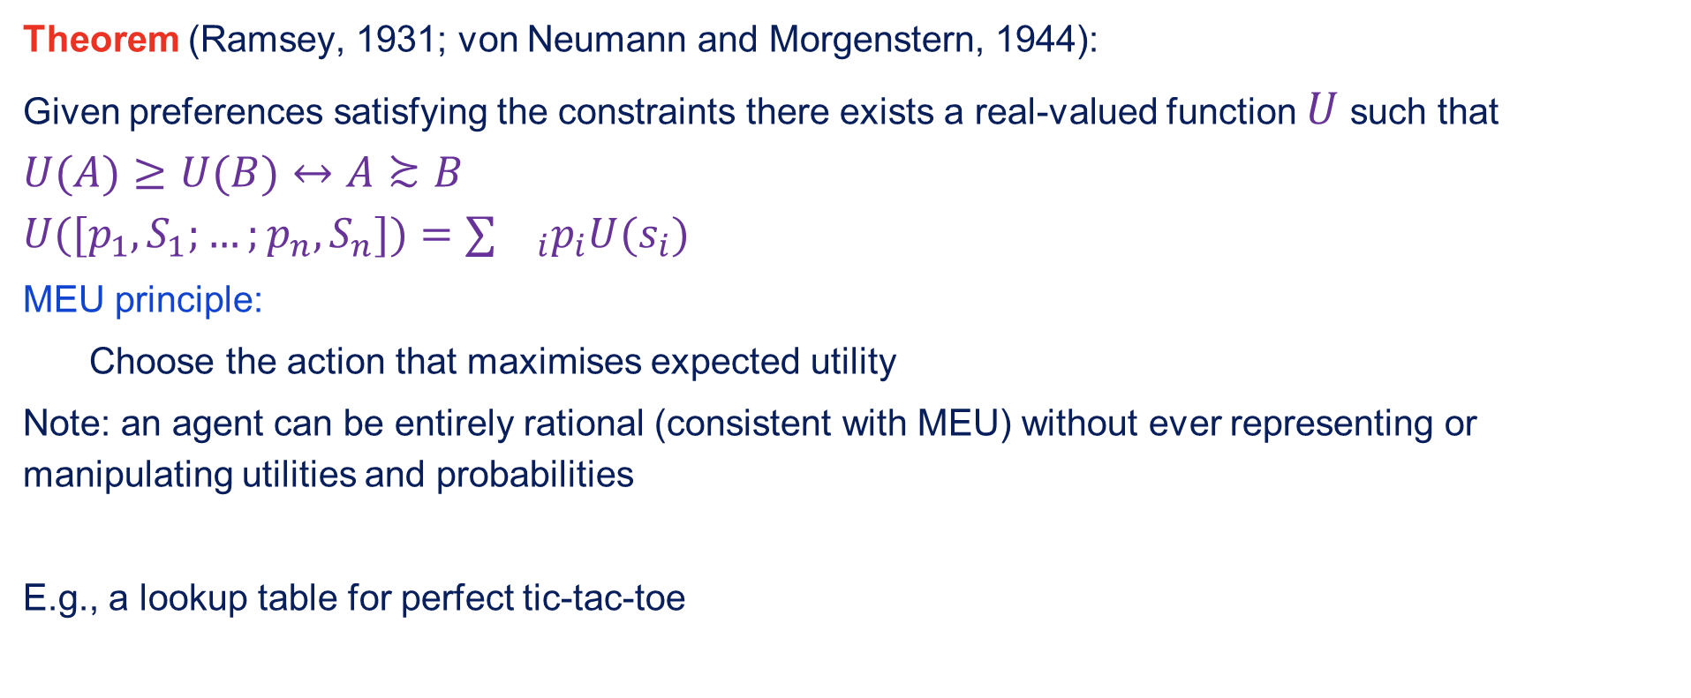
Maximising expected utility
Theorem (Ramsey, 1931; von Neumann and Morgenstern, 1944):
Given preferences satisfying the constraints there exists a real-valued function $U$ such that
$$U(A)≥U(B)↔A≿B$$
$$U([p_{1},S_{1};…;p_{n},S_{n}])=∑{}_{i}p_{i}U(s_{i})$$
MEU principle:
Choose the action that maximises expected utility
Note: an agent can be entirely rational (consistent with MEU) without ever representing or manipulating utilities and probabilities
E.g., a lookup table for perfect tic-tac-toe

Slide 7
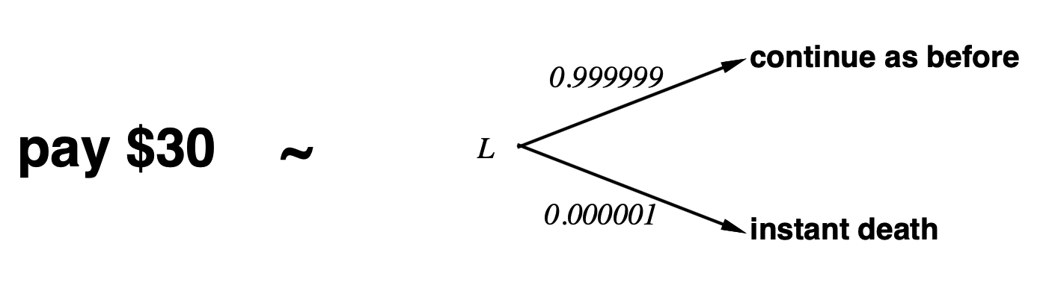
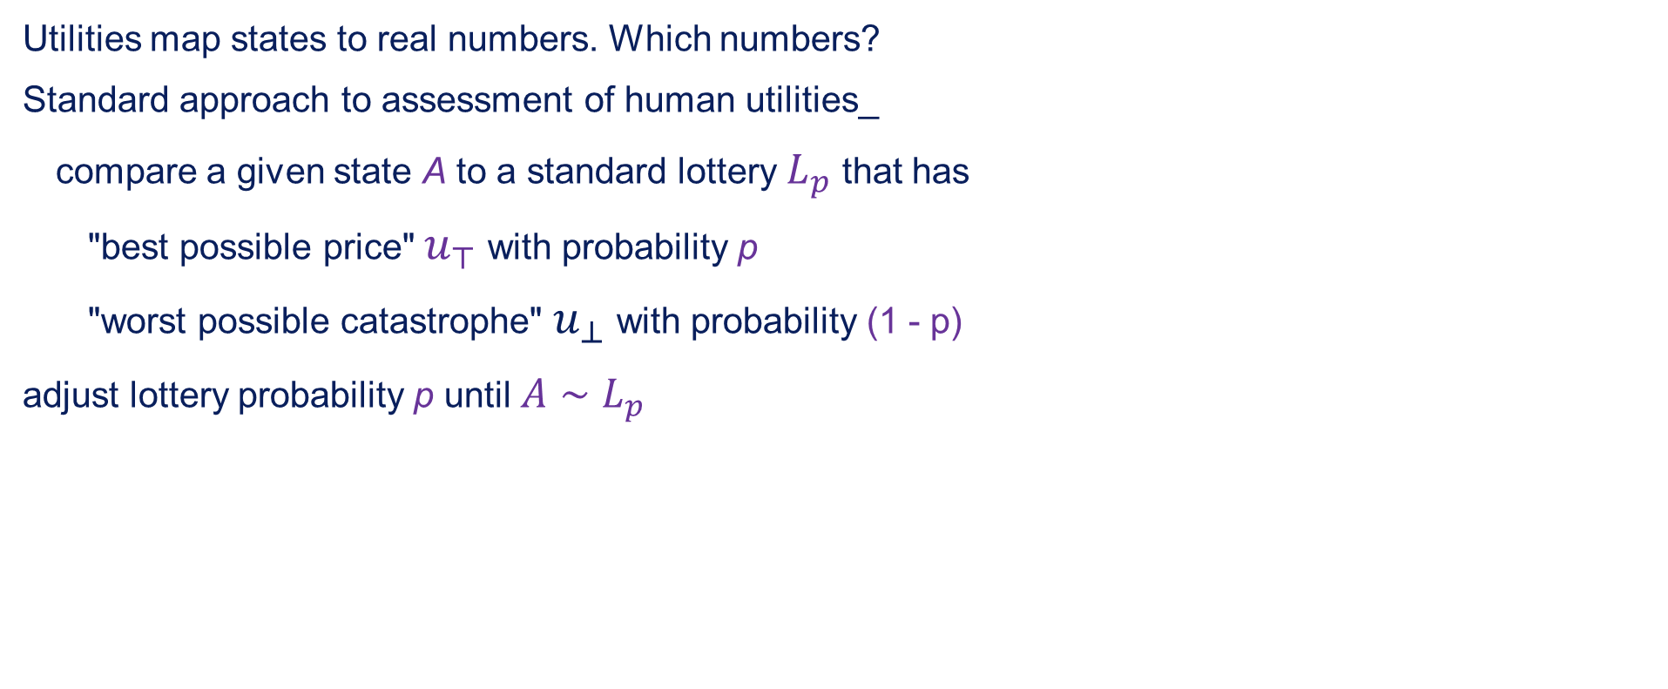
Utilities
Utilities map states to real numbers. Which numbers?
Standard approach to assessment of human utilities_
compare a given state A to a standard lottery $L_{p}$ that has
"best possible price" $u_{⊤}$ with probability p
"worst possible catastrophe" $u_{⊥}$ with probability (1 - p)
adjust lottery probability p until $A∼L_{p}$

Slide 8
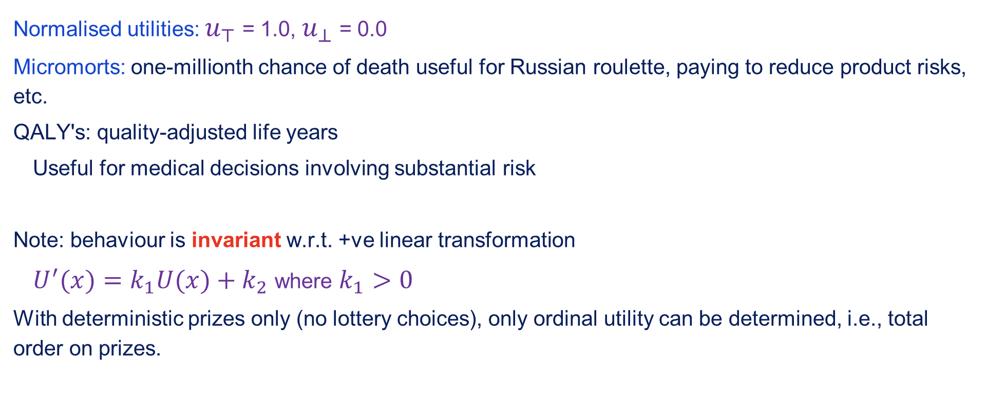
Utility scales
Normalised utilities: $u_{⊤}$ = 1.0, $u_{⊥}$ = 0.0
Micromorts: one-millionth chance of death useful for Russian roulette, paying to reduce product risks, etc.
QALY's: quality-adjusted life years
Useful for medical decisions involving substantial risk
Note: behaviour is invariant w.r.t. +ve linear transformation
$U^{′}(x)=k_{1}U(x)+k_{2}$ where $k_{1}>0$
With deterministic prizes only (no lottery choices), only ordinal utility can be determined, i.e., total order on prizes.

Slide 9
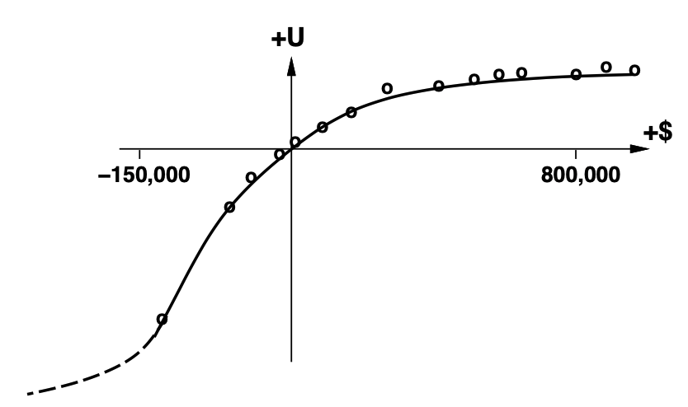
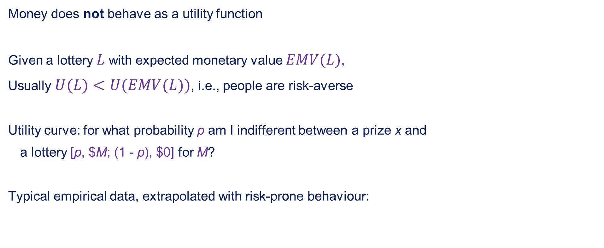
Money
Money does not behave as a utility function
Given a lottery $L$ with expected monetary value $EMV(L)$,
Usually $U(L)<U(EMV(L))$, i.e., people are risk-averse
Utility curve: for what probability p am I indifferent between a prize x and
a lottery [p, $M; (1 - p), $0] for M?
Typical empirical data, extrapolated with risk-prone behaviour:

Slide 10
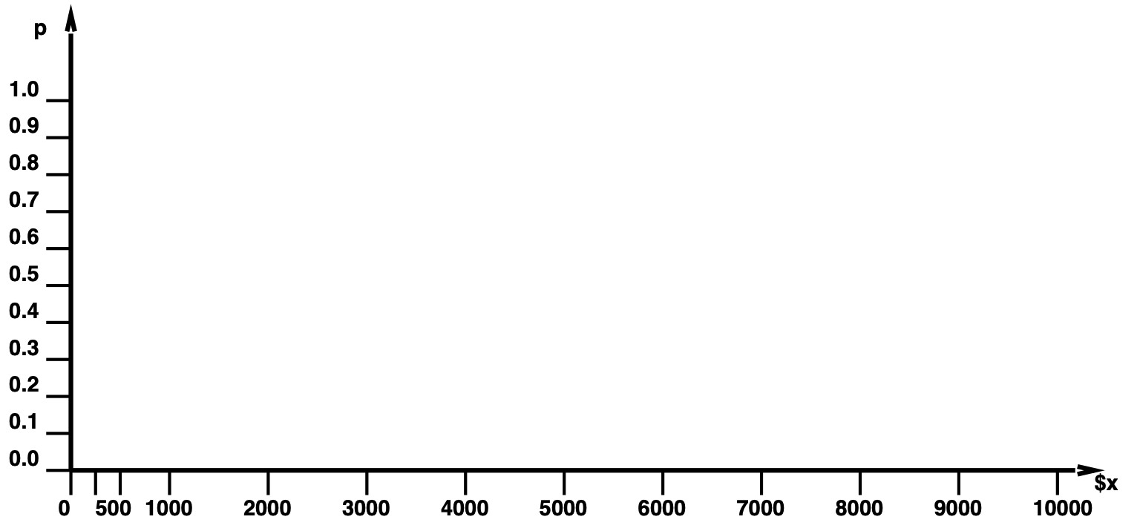
Student group utility
For each x, adjust p until half the class votes for lottery (M = 10,000)

Slide 11
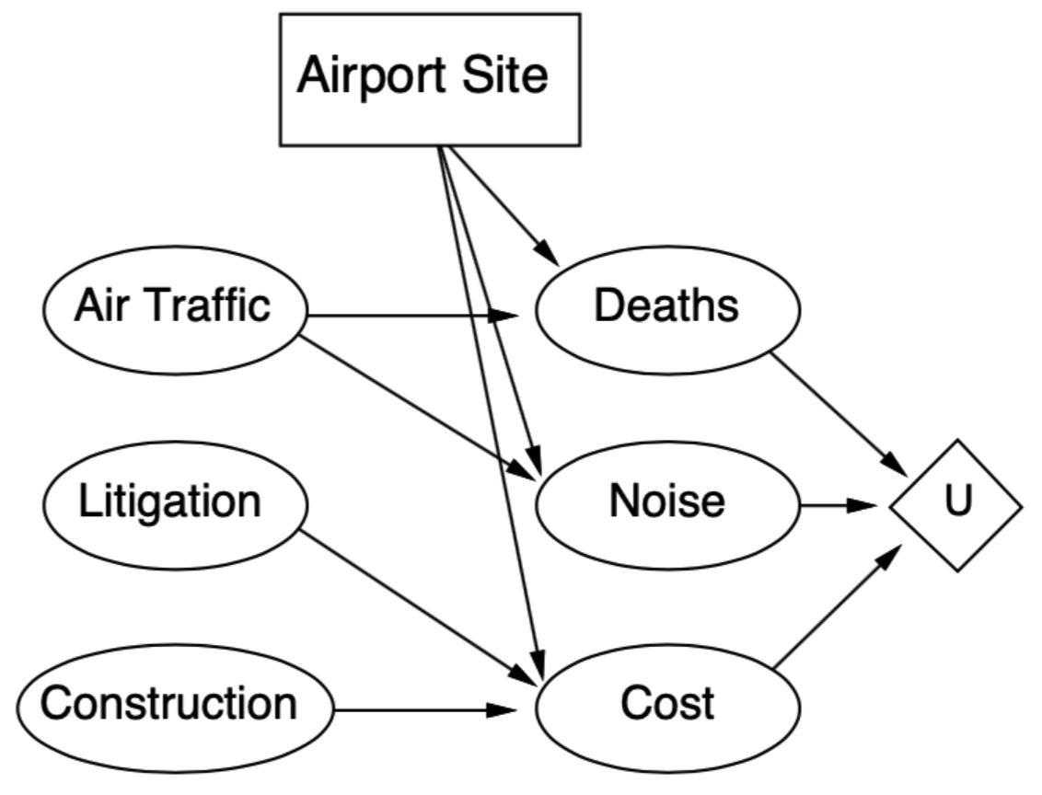
Decision networks
Add action nodes to utility nodes to belief networks
to enable rational decision making
Algorithm:
For each value of action node
compute expected value of utility node given action, evidence
Return MEU action

Slide 12
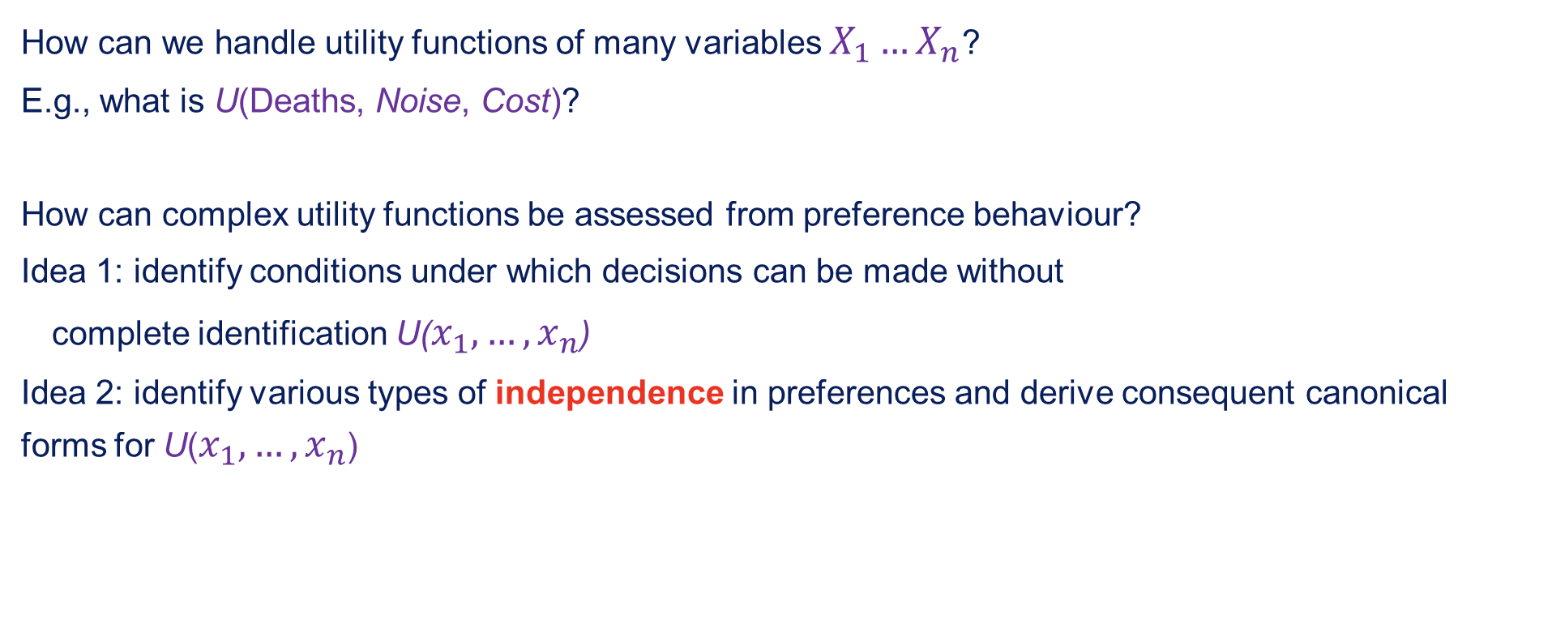
Multiattribute utility
How can we handle utility functions of many variables $X_{1}…X_{n}$?
E.g., what is U(Deaths, Noise, Cost)?
How can complex utility functions be assessed from preference behaviour?
Idea 1: identify conditions under which decisions can be made without
complete identification U($x_{1},…,x_{n}$)
Idea 2: identify various types of independence in preferences and derive consequent canonical forms for U($x_{1},…,x_{n}$)

Slide 13
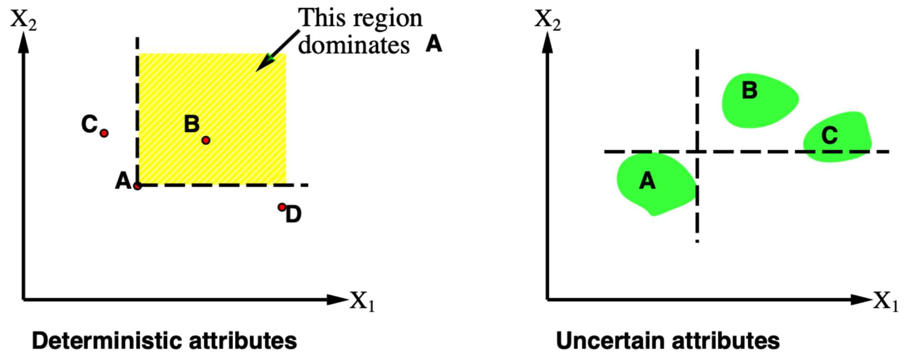
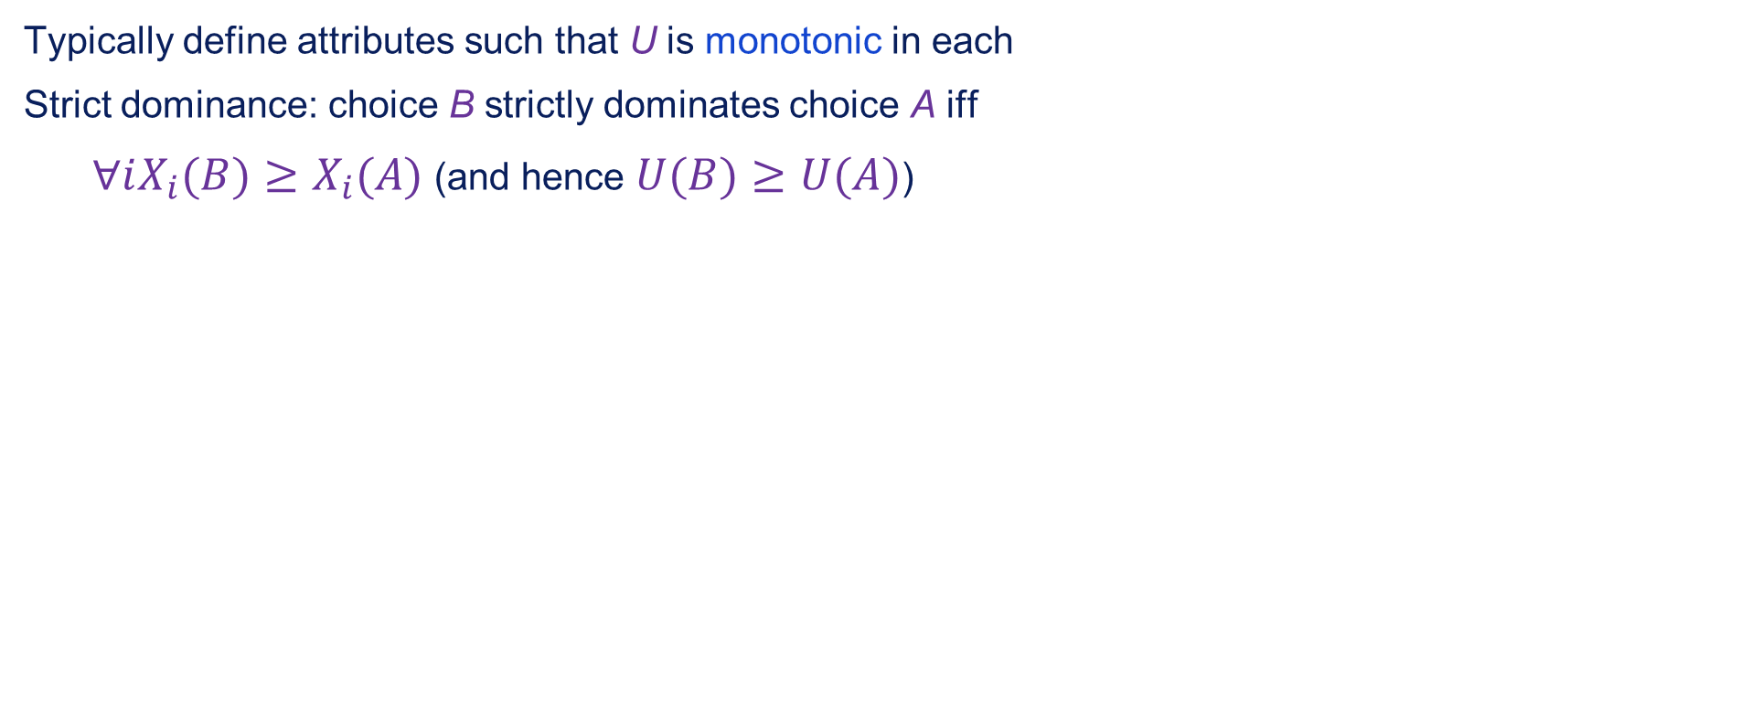
Strict dominance
Typically define attributes such that U is monotonic in each
Strict dominance: choice B strictly dominates choice A iff
$∀iX_{i}(B)≥X_{i}(A)$ (and hence $U(B)≥U(A)$)

Slide 14
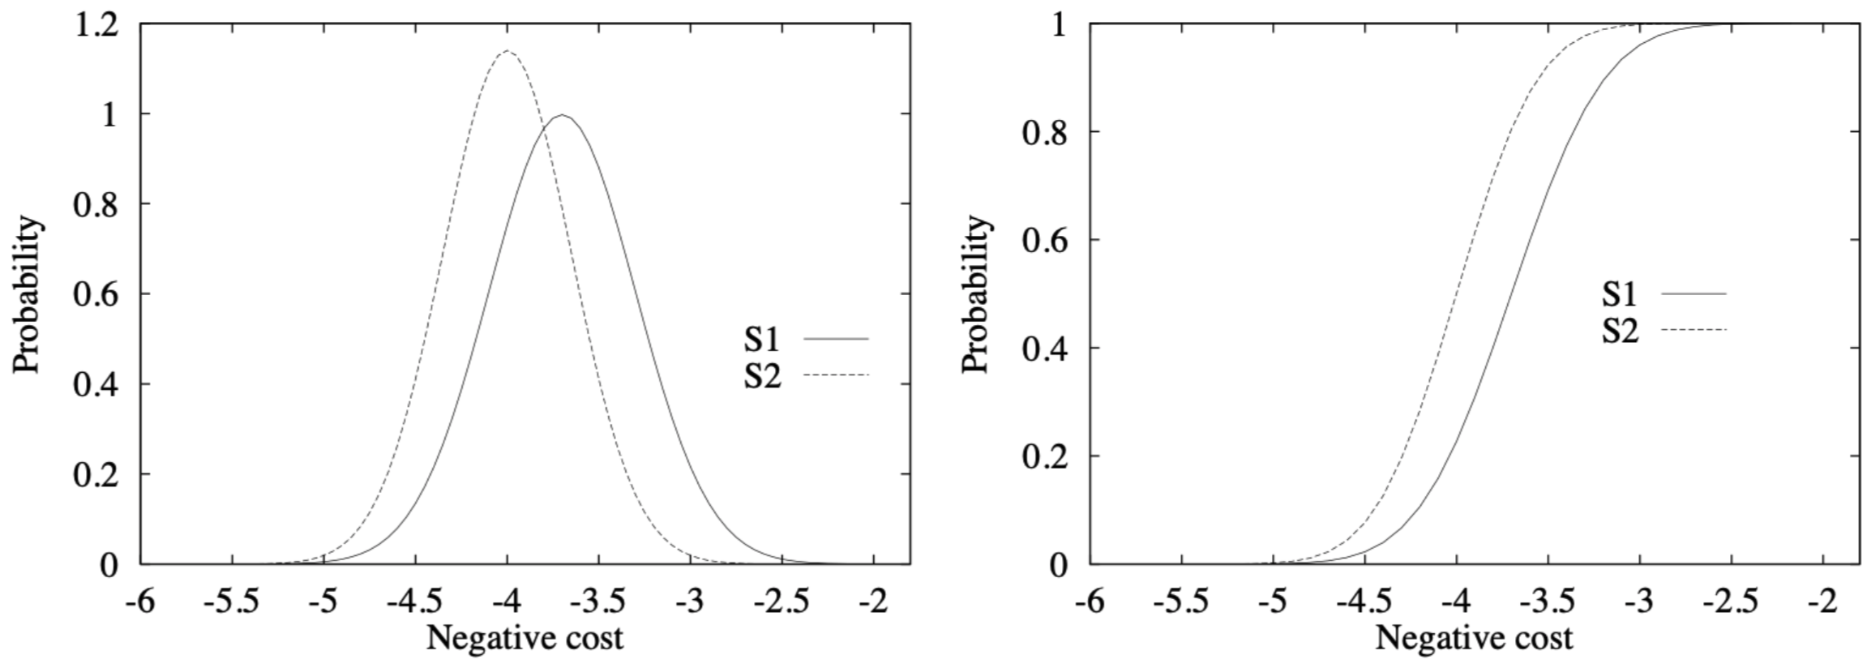
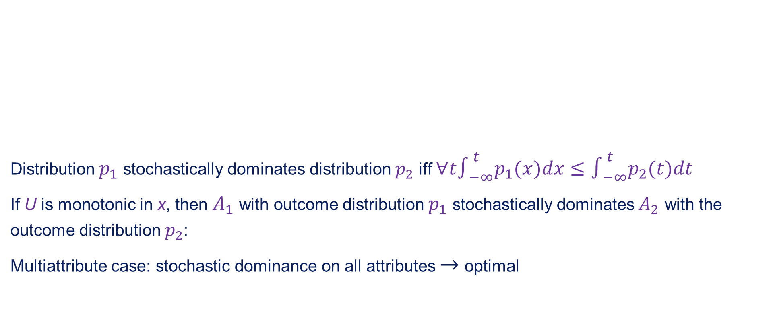
Stochastic dominance
Distribution $p_{1}$ stochastically dominates distribution $p_{2}$ iff $∀t∫_{−∞}^{t}p_{1}(x)dx≤∫_{−∞}^{t}p_{2}(t)dt$
If U is monotonic in x, then $A_{1}$ with outcome distribution $p_{1}$ stochastically dominates $A_{2}$ with the outcome distribution $p_{2}$:
Multiattribute case: stochastic dominance on all attributes $→$ optimal

Slide 15
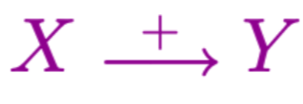
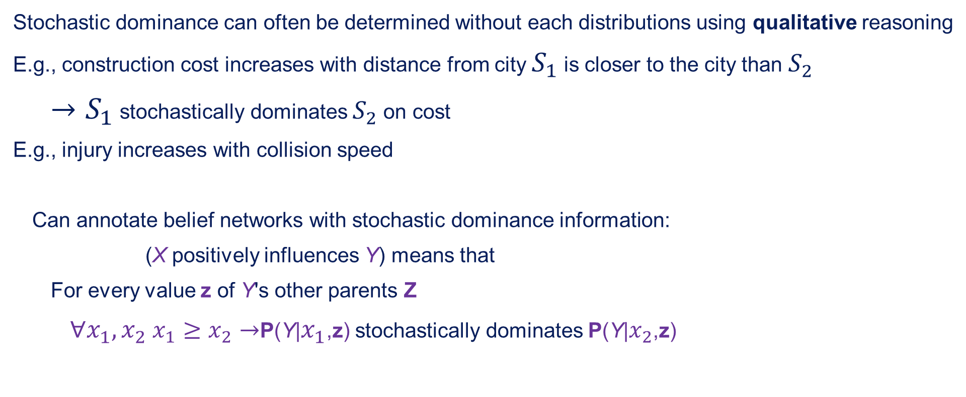
Stochastic dominance continued
Stochastic dominance can often be determined without each distributions using qualitative reasoning
E.g., construction cost increases with distance from city $S_{1}$ is closer to the city than $S_{2}$
$→S_{1}$ stochastically dominates $S_{2}$ on cost
E.g., injury increases with collision speed
Can annotate belief networks with stochastic dominance information:
(X positively influences Y) means that
For every value z of Y's other parents Z
$∀x_{1},x_{2}$ $x_{1}≥x_{2}→$P(Y|$x_{1}$,z) stochastically dominates P(Y|$x_{2}$,z)

Slide 16
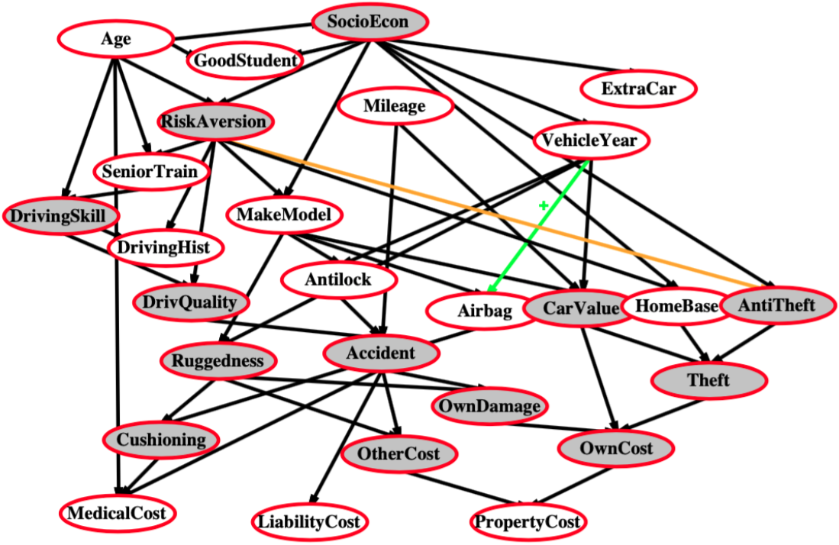
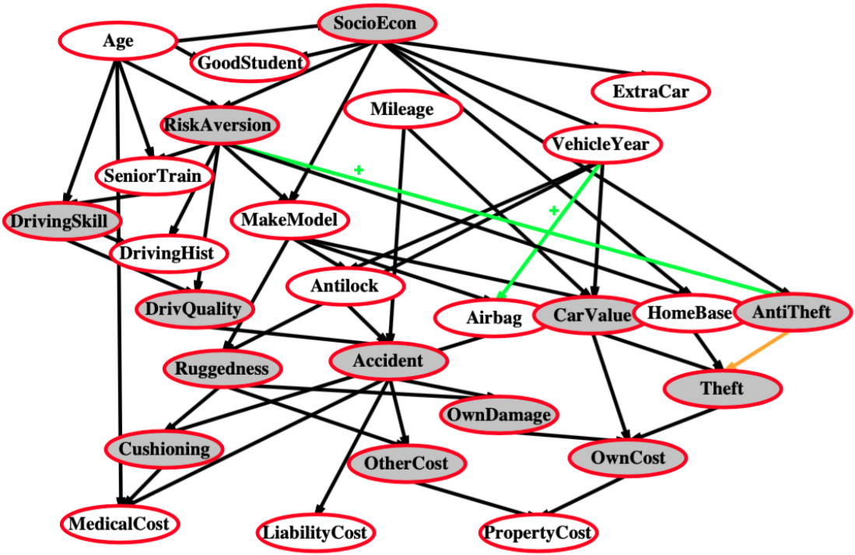
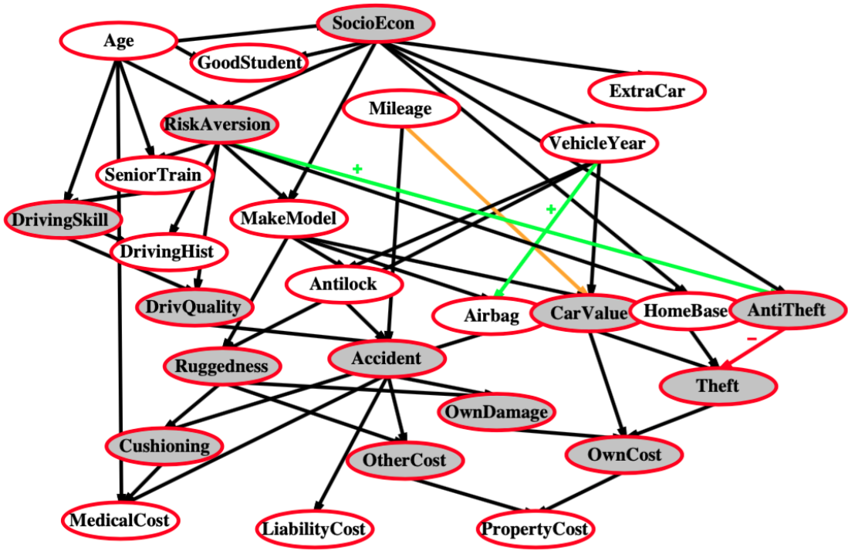
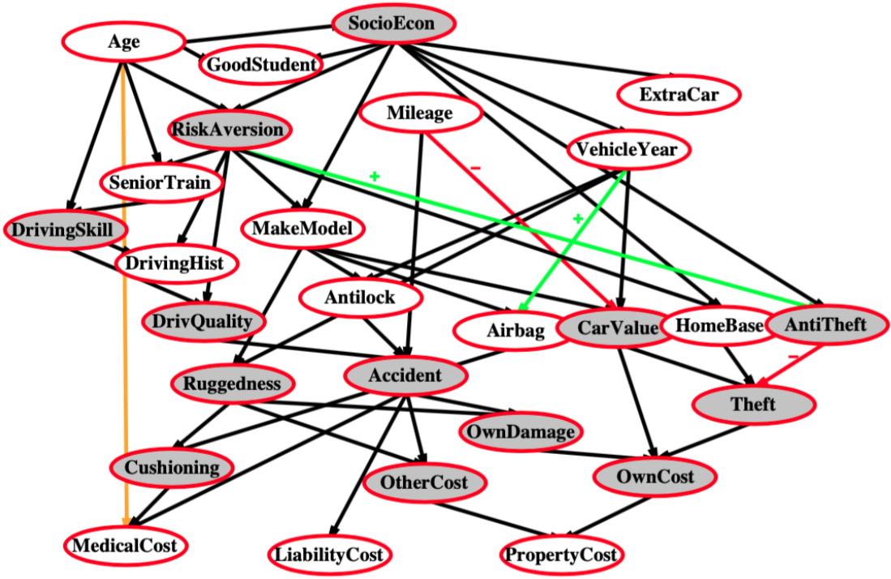
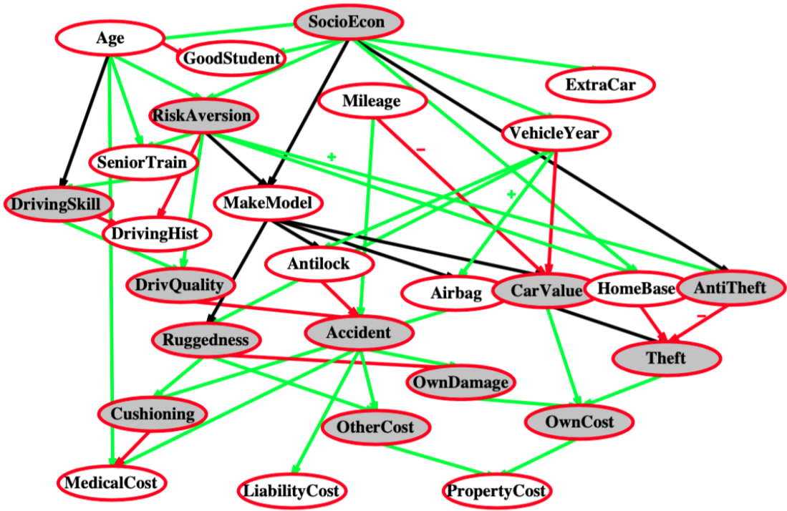
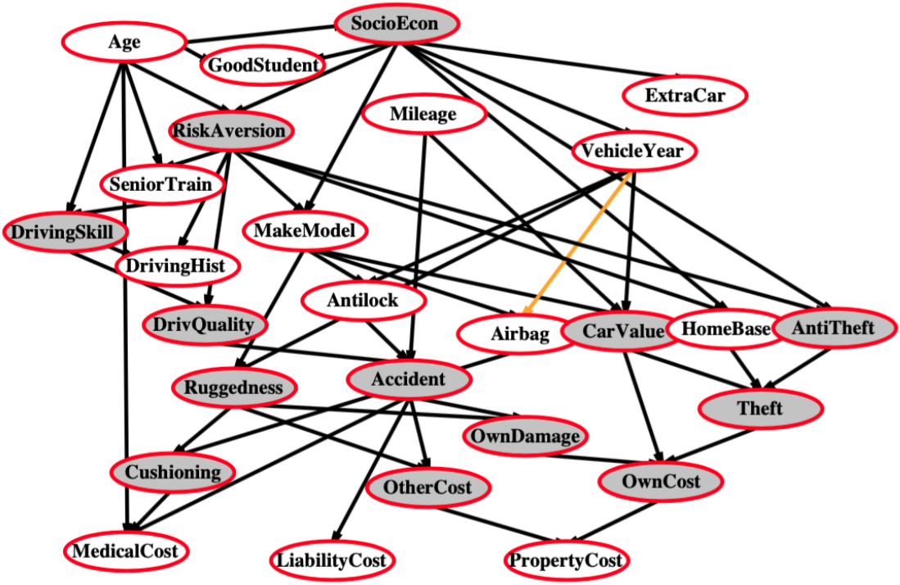
Label the arcs + or –

Slide 17
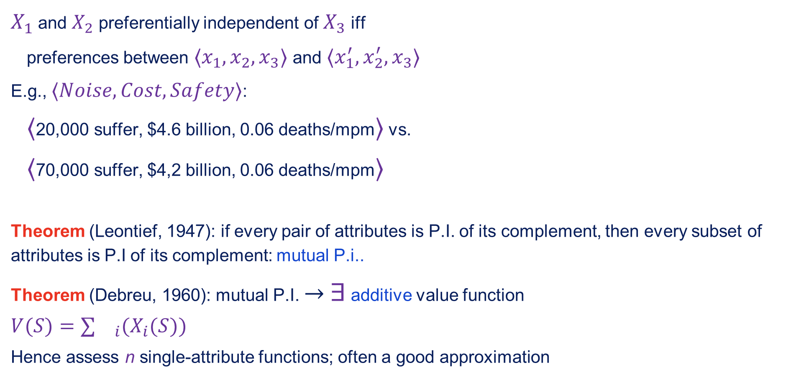
Preference structure: Deterministic
$X_{1}$ and $X_{2}$ preferentially independent of $X_{3}$ iff
preferences between $⟨x_{1},x_{2},x_{3}⟩$ and $⟨x_{1}^{′},x_{2}^{′},x_{3}⟩$
E.g., $⟨Noise,Cost,Safety⟩$:
$⟨$20,000 suffer, $4.6 billion, 0.06 deaths/mpm$⟩$ vs.
$⟨$70,000 suffer, $4,2 billion, 0.06 deaths/mpm$⟩$
Theorem (Leontief, 1947): if every pair of attributes is P.I. of its complement, then every subset of attributes is P.I of its complement: mutual P.i..
Theorem (Debreu, 1960): mutual P.I. $→$ $∃$ additive value function
$$V(S)=∑{}_{i}(X_{i}(S))$$
Hence assess n single-attribute functions; often a good approximation

Slide 18
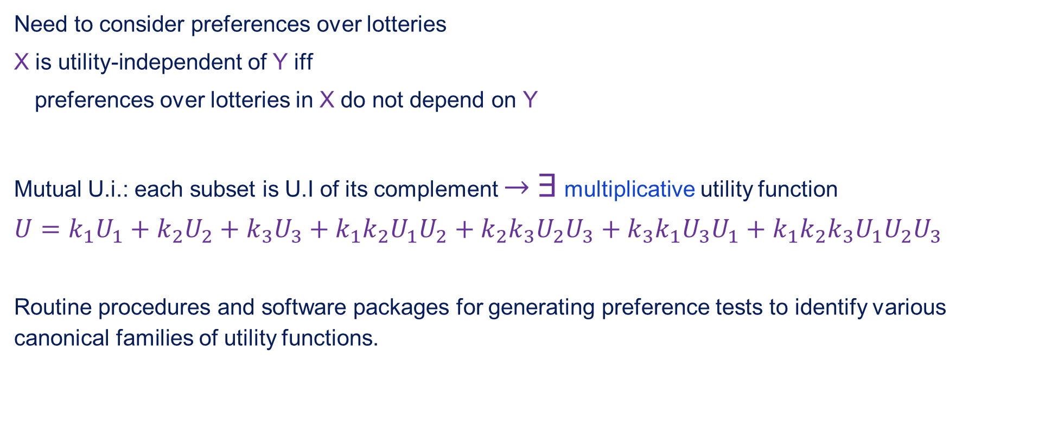
Preference structure: Stochastic
Need to consider preferences over lotteries
X is utility-independent of Y iff
preferences over lotteries in X do not depend on Y
Mutual U.i.: each subset is U.I of its complement $→$ $∃$ multiplicative utility function
$$U=k_{1}U_{1}+k_{2}U_{2}+k_{3}U_{3}+k_{1}k_{2}U_{1}U_{2}+k_{2}k_{3}U_{2}U_{3}+k_{3}k_{1}U_{3}U_{1}+k_{1}k_{2}k_{3}U_{1}U_{2}U_{3}$$
Routine procedures and software packages for generating preference tests to identify various canonical families of utility functions.

Slide 19
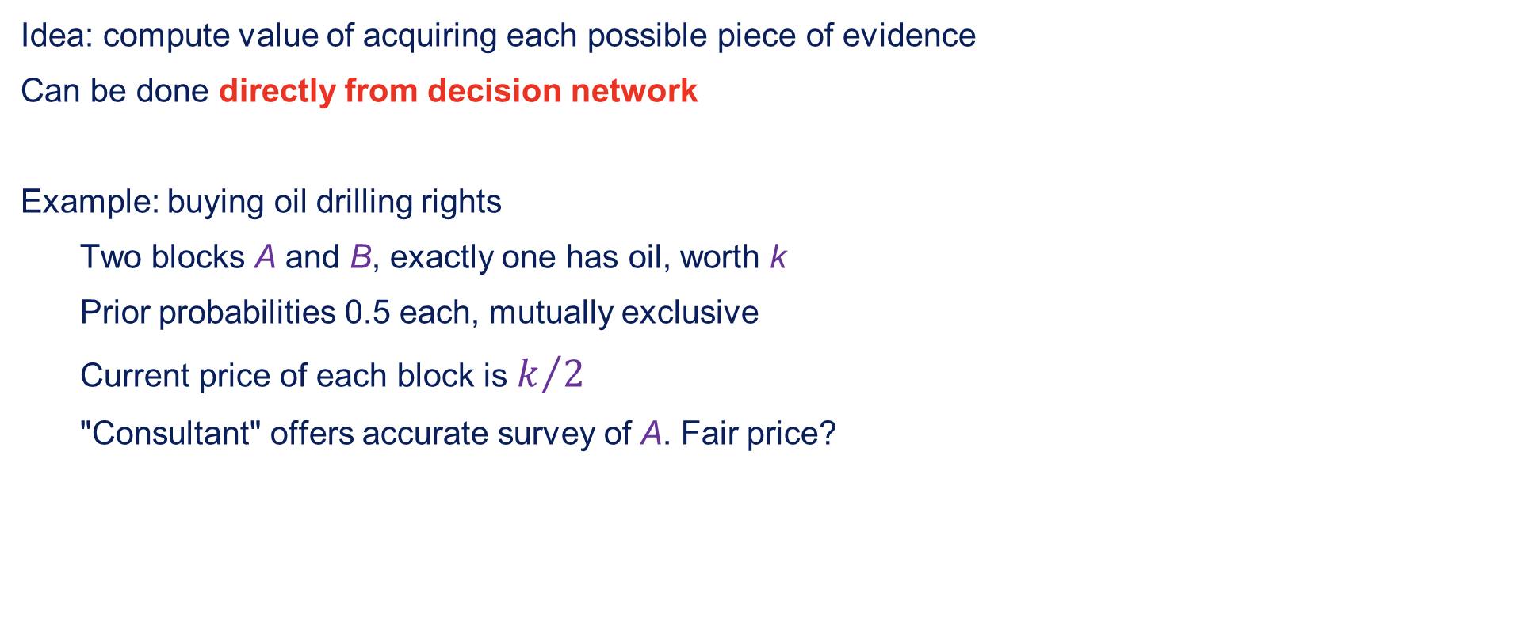
Value of information
Idea: compute value of acquiring each possible piece of evidence
Can be done directly from decision network
Example: buying oil drilling rights
Two blocks A and B, exactly one has oil, worth k
Prior probabilities 0.5 each, mutually exclusive
Current price of each block is $k/2$
"Consultant" offers accurate survey of A. Fair price?

Slide 20
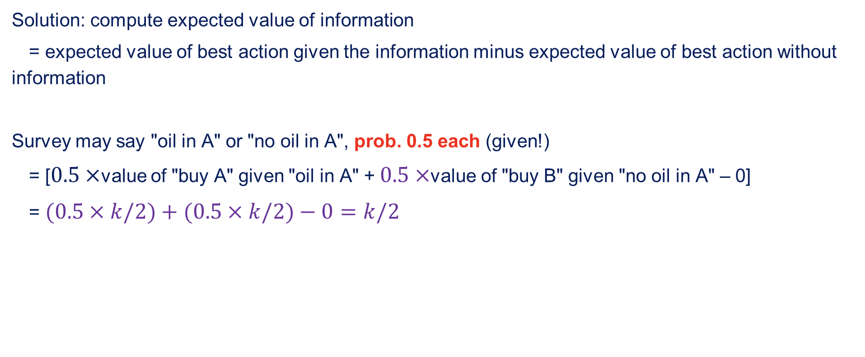
Value of information cont.
Solution: compute expected value of information
= expected value of best action given the information minus expected value of best action without information
Survey may say "oil in A" or "no oil in A", prob. 0.5 each (given!)
= [$0.5×$value of "buy A" given "oil in A" + $0.5×$value of "buy B" given "no oil in A" – 0]
= $(0.5×k/2)+(0.5×k/2)−0=k/2$

Slide 21
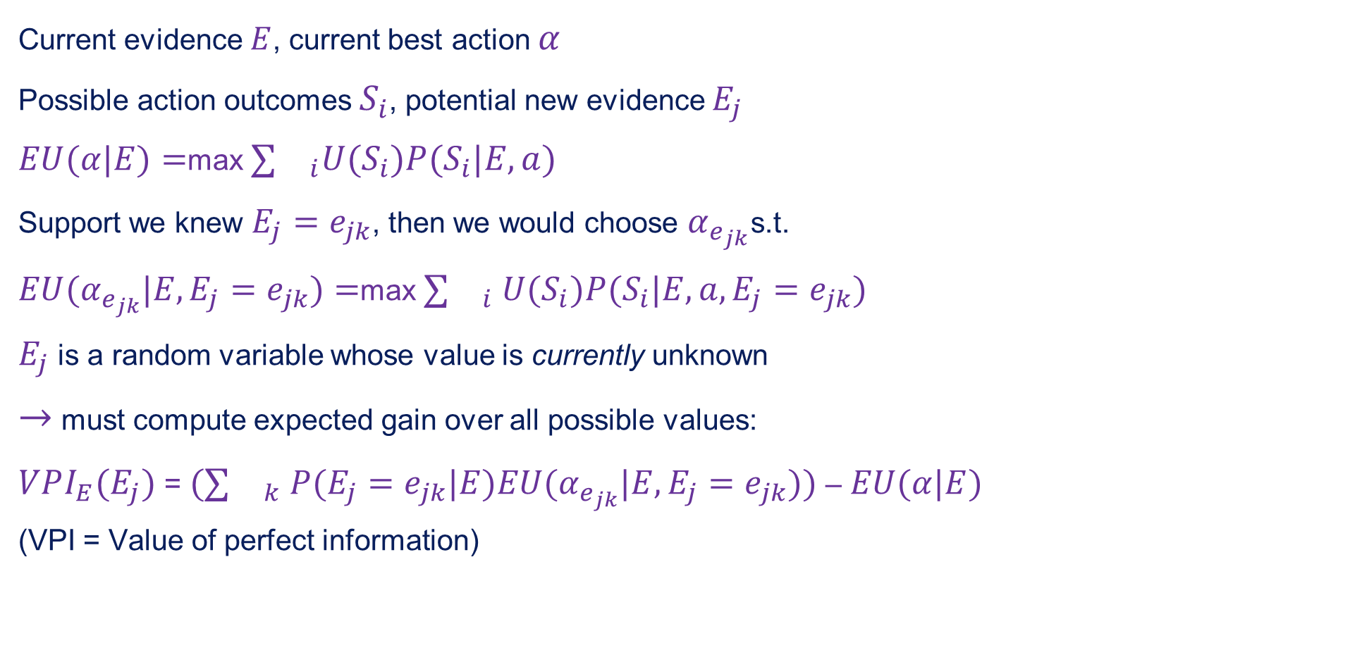
General formula
Current evidence $E$, current best action $α$
Possible action outcomes $S_{i}$, potential new evidence $E_{j}$
$EU(α|E)=$max $∑{}_{i}U(S_{i})P(S_{i}|E,a)$
Support we knew $E_{j}=e_{jk}$, then we would choose $α_{e_{jk}}$s.t.
$EU(α_{e_{jk}}|E,E_{j}=e_{jk})=$max $∑{}_{i}$ $U(S_{i})P(S_{i}|E,a,E_{j}=e_{jk})$
$E_{j}$ is a random variable whose value is currently unknown
$→$ must compute expected gain over all possible values:
$VPI_{E}(E_{j})$ = $(∑{}_{k}$ $P(E_{j}=e_{jk}|E)EU(α_{e_{jk}}|E,E_{j}=e_{jk}))$ – $EU(α|E)$
(VPI = Value of perfect information)
a
a

Slide 22
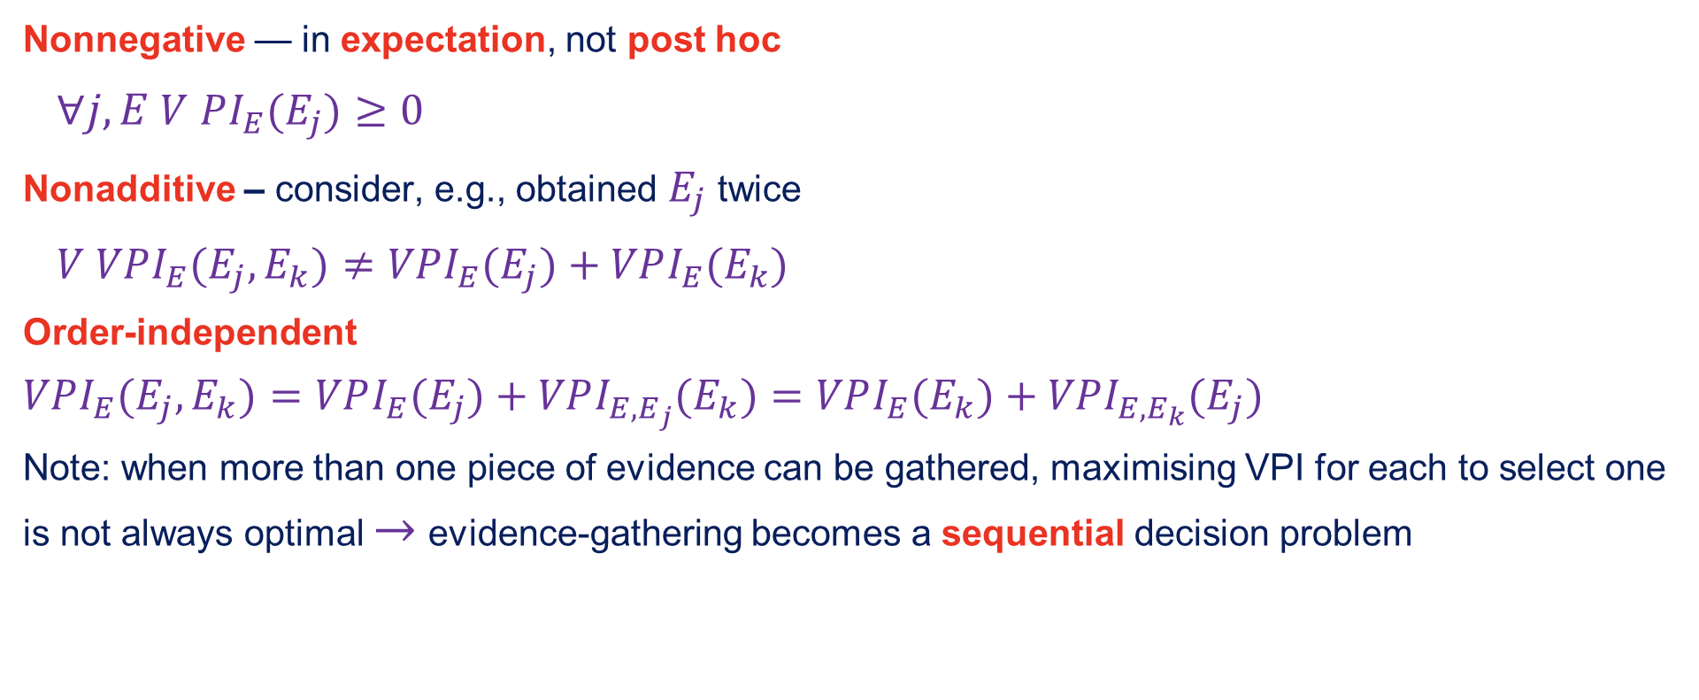
Properties
Nonnegative — in expectation, not post hoc
$∀j,E$ $V$ $PI_{E}(E_{j})≥0$
Nonadditive – consider, e.g., obtained $E_{j}$ twice
$V$ $VPI_{E}(E_{j},E_{k})≠VPI_{E}(E_{j})+VPI_{E}(E_{k})$
Order-independent
$$VPI_{E}(E_{j},E_{k})=VPI_{E}(E_{j})+VPI_{E,E_{j}}(E_{k})=VPI_{E}(E_{k})+VPI_{E,E_{k}}(E_{j})$$
Note: when more than one piece of evidence can be gathered, maximising VPI for each to select one is not always optimal $→$ evidence-gathering becomes a sequential decision problem

Slide 23
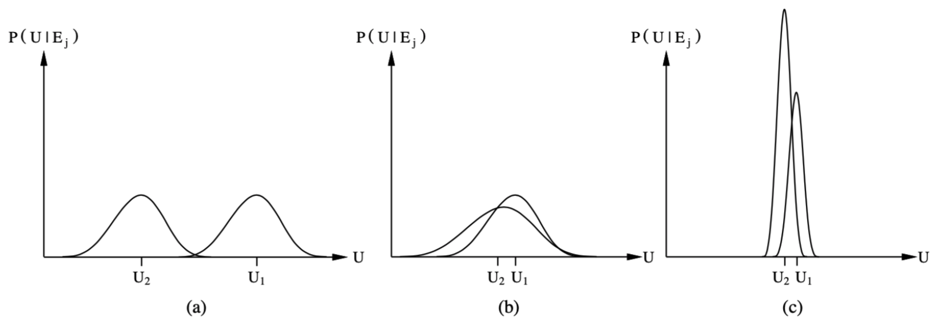
Qualitative behaviours
Choice is obvious, information worth little
Choice is nonobvious, information worth a lot
Choice is nonobvious, information worth little

